Slide 1
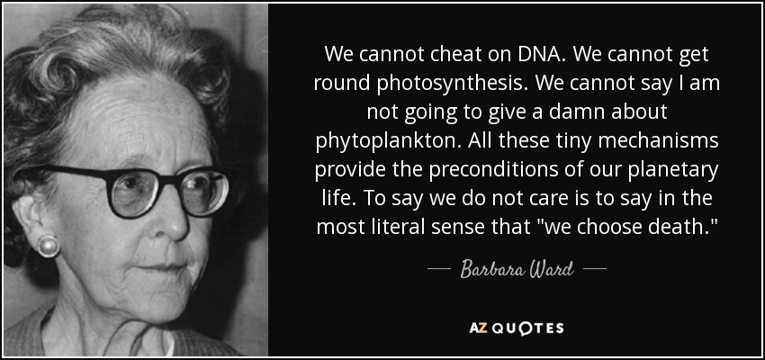

Slide 2
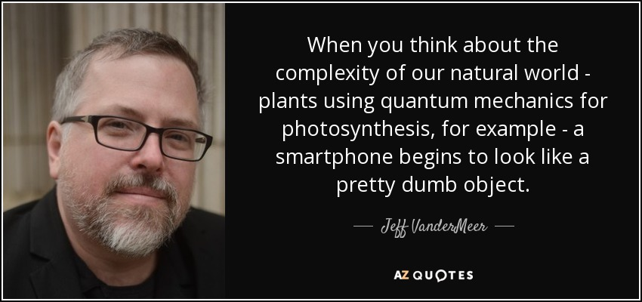

Slide 3
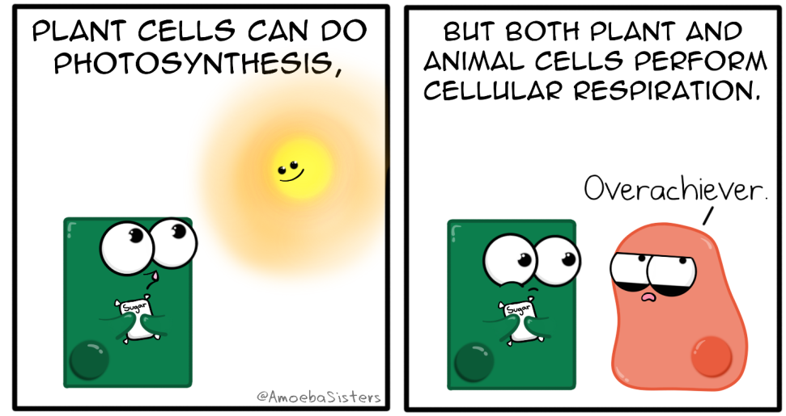


Slide 4
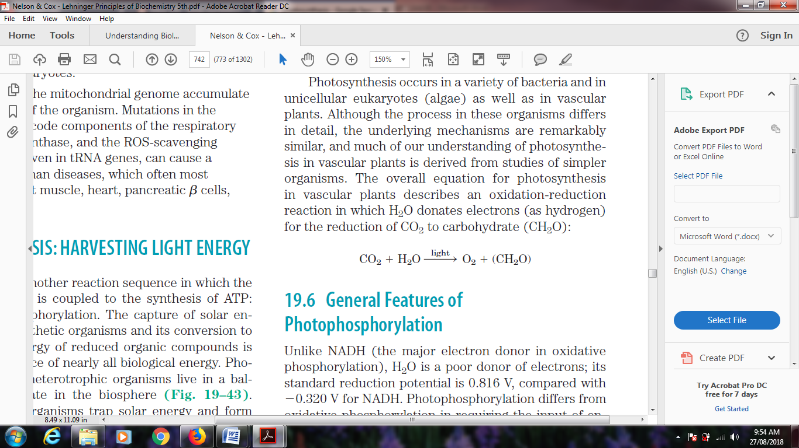
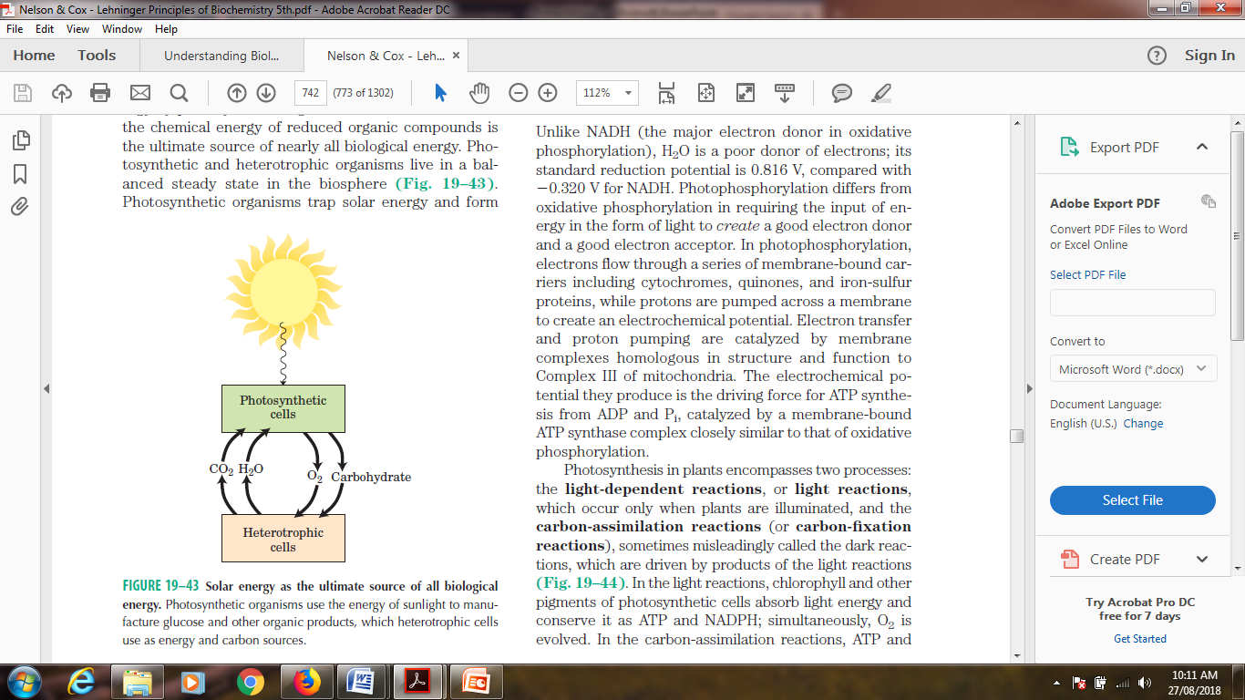
Photophosphorylation

Slide 5
Photophosphorylation
Similarities and Differences between photophosphorylation and Oxidative phosphorylation
Features | Photophosphorylation | Oxidative phosphorylation
Electron Donor | H₂O | NADH, FADH₂
Standard Reduction potential | 0.816 V | -3.20 V
Energy required to create a donor | Light | None

Slide 6

Photophosphorylation
Similarities and Differences between photophosphorylation and Oxidative phosphorylation
Features | Photo-phosphorylation | Oxidative phosphorylation
Electron flow
Series of membrane bound carriers
Ubiquinone, Cytochrome c, Iron-Sulphur clusters

Slide 7
Photosynthesis in plants encompasses two processes:
the light-dependent reactions, or light reactions, which occur only when plants are illuminated
carbon-assimilation reactions (or carbon-fixation reactions), sometimes misleadingly called the dark reactions, which are driven by products of the light reactions.
In the light reactions, chlorophyll and other pigments of photosynthetic cells absorb light energy and conserve it as ATP and NADPH; simultaneously, O2 is evolved.
In the carbon-assimilation reactions, ATP and NADPH are used to reduce CO2 to form triose phosphates, starch, and sucrose, and other products derived from them.

Slide 8
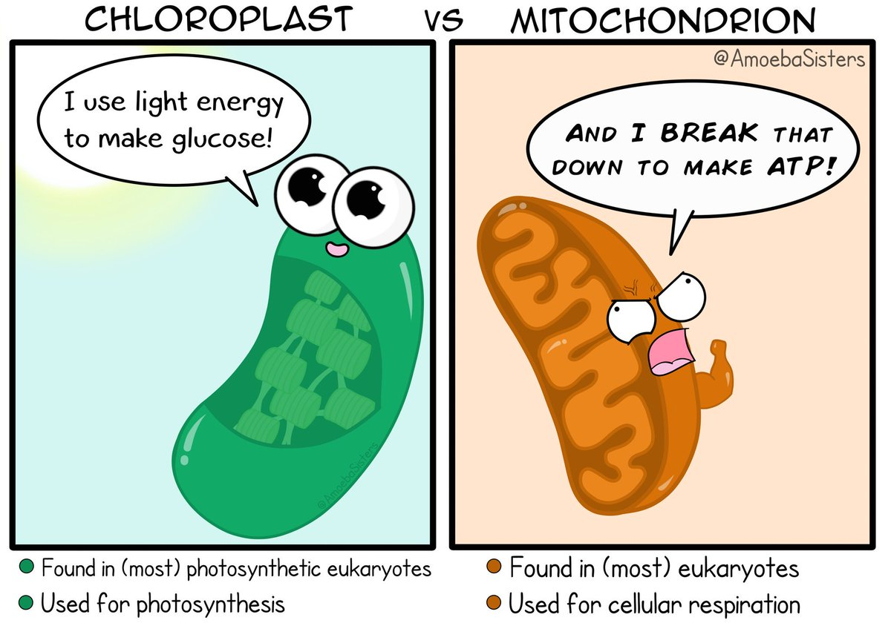
Site of Photophosphorylation

Slide 9
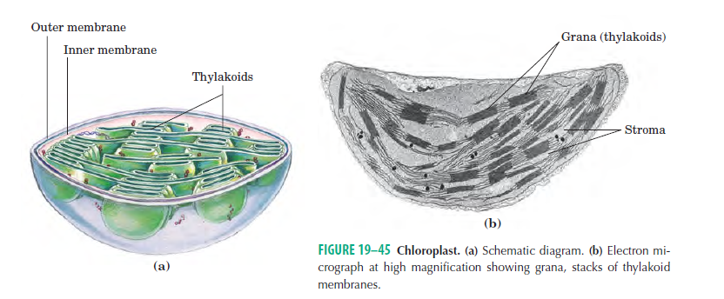
Site of Photophosphorylation

Slide 10
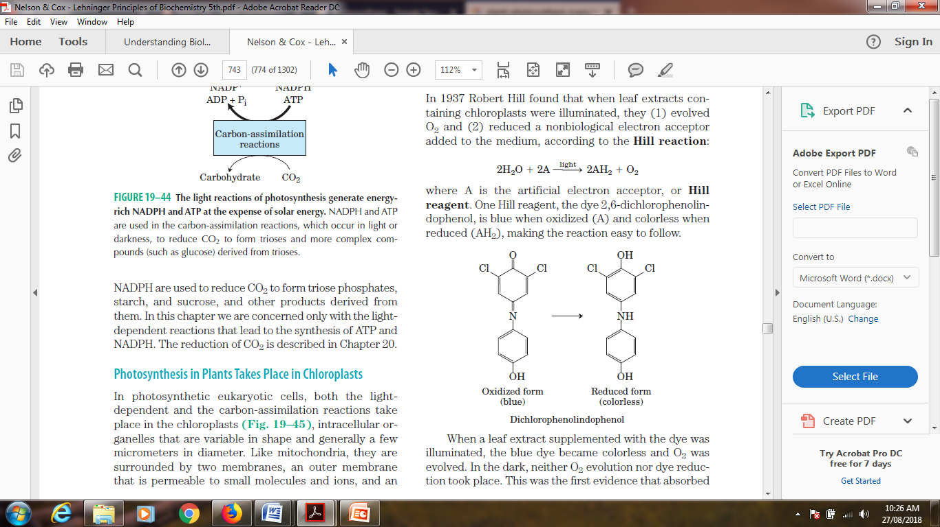
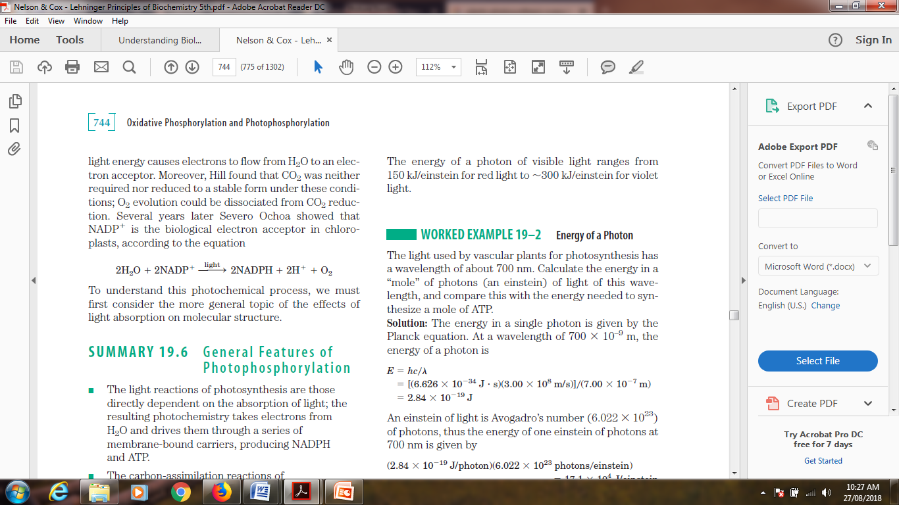
Historical background: Hill reaction

Slide 11
Light absorption
When a photon is absorbed, an electron in the absorbing molecule (chromophore) is lifted to a higher energy level. This is an all-or-nothing event; to be absorbed, the photon must contain a quantity of energy (a quantum) that exactly matches the energy of the electronic transition. A molecule that has absorbed a photon is in an excited state, which is generally unstable. An electron lifted into a higher-energy orbital usually returns rapidly to its lower-energy orbital; the excited molecule decays to the stable ground state, giving up the absorbed quantum as light or heat or using it to do chemical work.

Slide 12
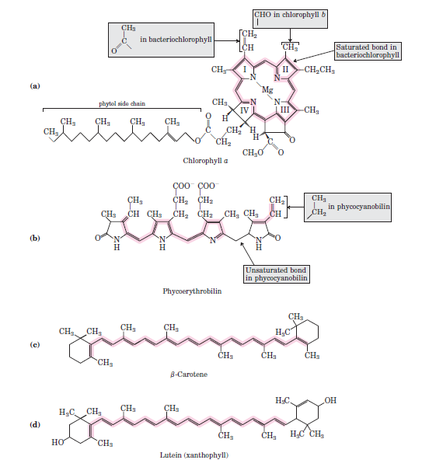
Light absorbing pigments

Slide 13
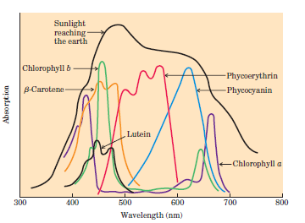
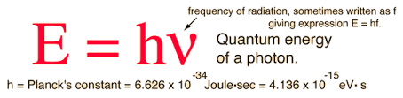
Light absorbing pigments
The most important light-absorbing pigments in the thylakoid membranes are the chlorophylls, green pigments with polycyclic, planar structures with Mg2+ occupies the central position.
The four inward-oriented nitrogen atoms of chlorophyll are coordinated with the Mg2+.
All chlorophylls have a long phytol side chain, esterified to a carboxyl-group substituent in ring IV.

Slide 14
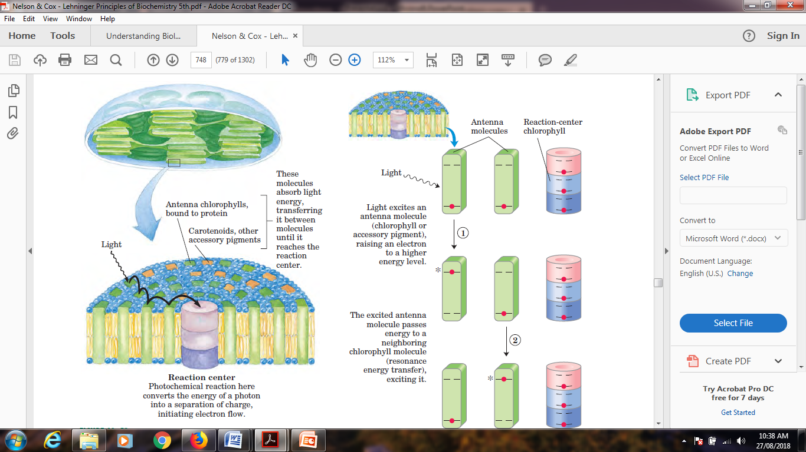
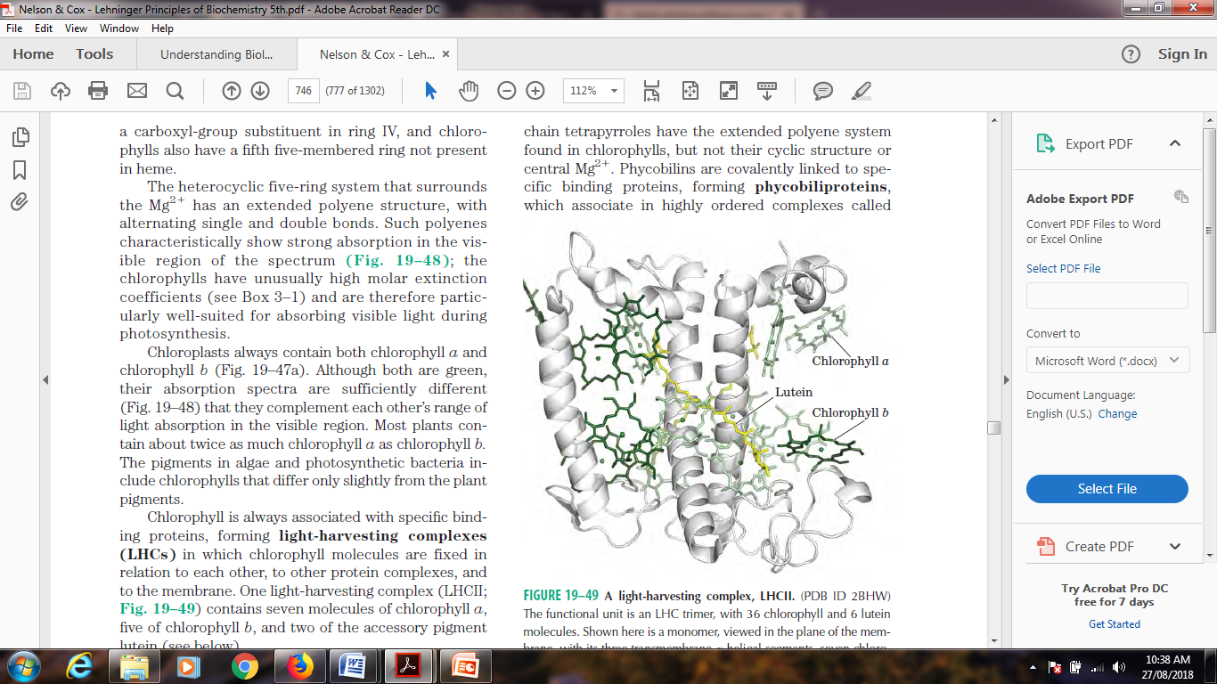
Organization of photosystems in the thylakoid membrane. Photosystems are tightly packed in the thylakoid membrane, with several hundred antenna chlorophylls and accessory pigments surrounding
a photoreaction center. Absorption of a photon by any of the antenna chlorophylls leads to excitation of the reaction center by exciton transfer (black arrow).

Slide 15
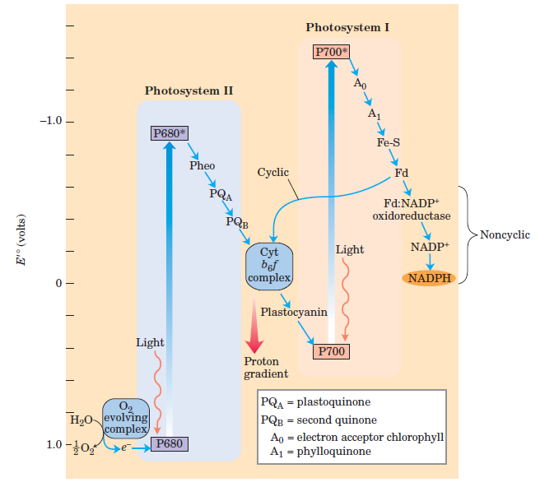
Non cyclic photophosphorylation in plants

Slide 16
Integration of photosystems I and II in chloroplasts:
1. “Z scheme” shows the pathway of electron transfer from H2O (lower left) to NADP (far right) in noncyclic photosynthesis. The position on the vertical scale of each electron carrier reflects its standard reduction potential.
2. To raise the energy of electrons derived from H2O to the energy level required to reduce NADP to NADPH, each electron must be “lifted” twice (heavy arrows) by photons absorbed in PSII and PSI.
3. One photon is required per electron in each photosystem. After excitation, the high-energy electrons flow “downhill” through the carrier chains shown. Protons move across the thylakoid membrane during the water splitting reaction and during electron transfer through the cytochrome b6f complex, producing the proton gradient that is essential to ATP formation.

Slide 17
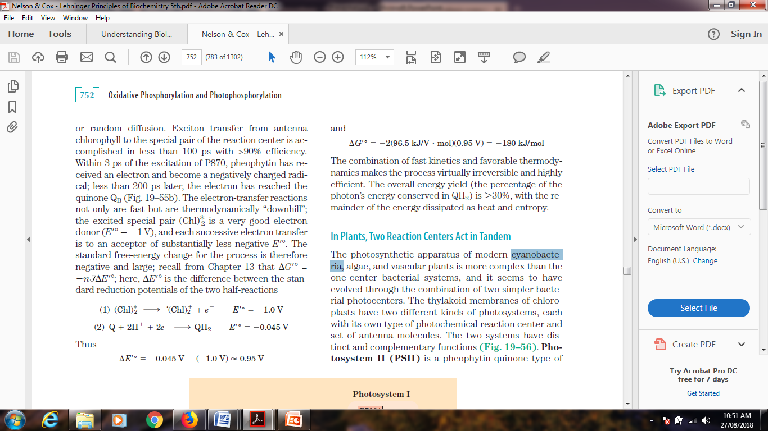
G = -n £E; here, E is the difference between the standard
reduction potentials of the two half-reactions-

Slide 18
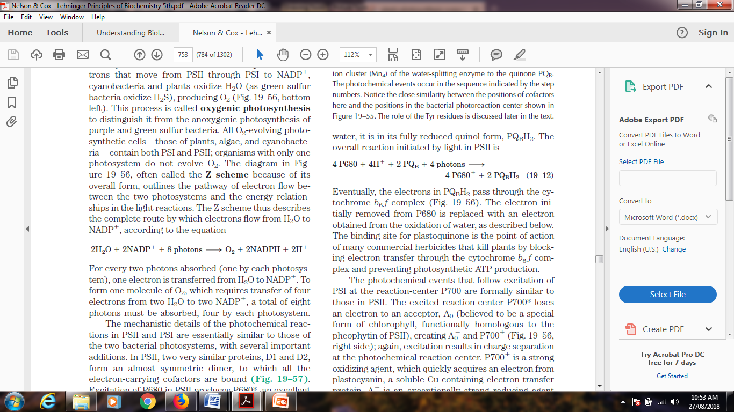
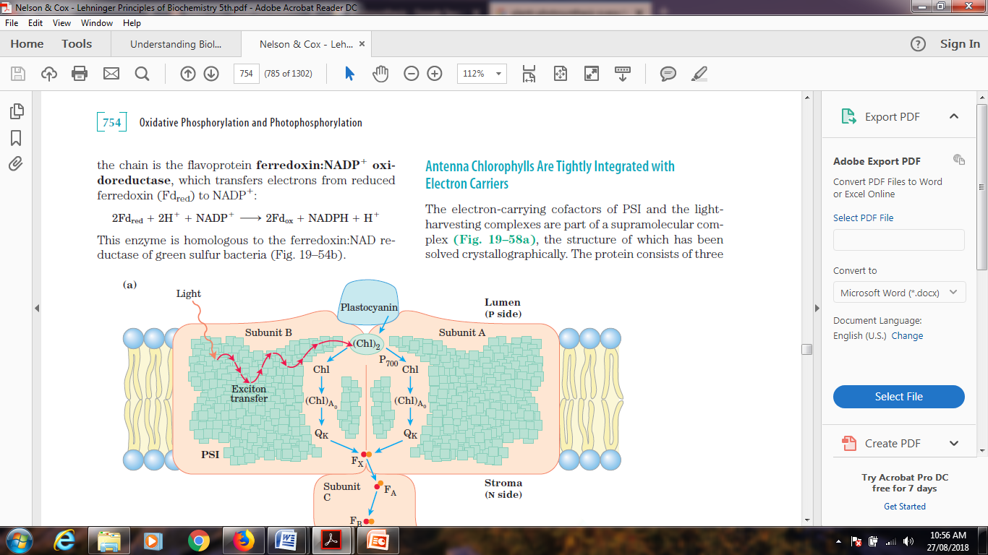
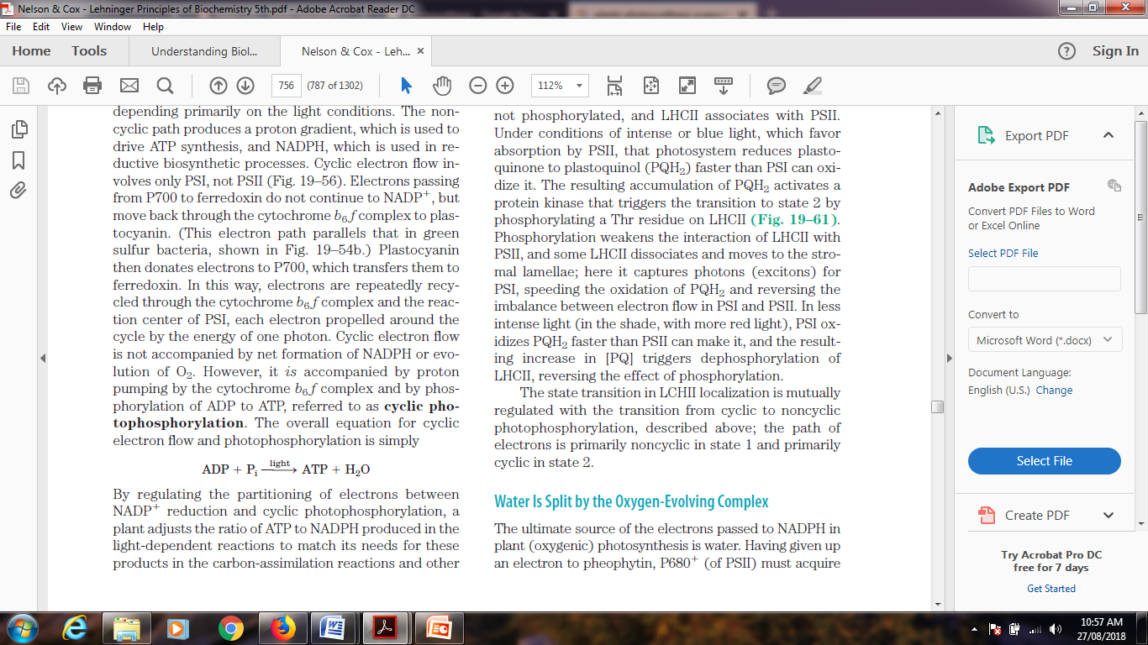
Important reactions
The Z scheme thus describes the complete route by which electrons flow from H2O to NADP, according to the equation

Slide 19
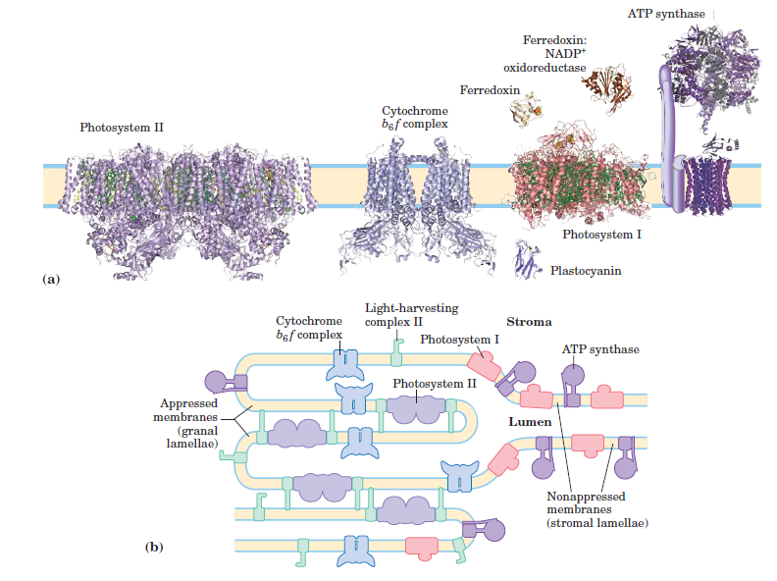

Slide 20
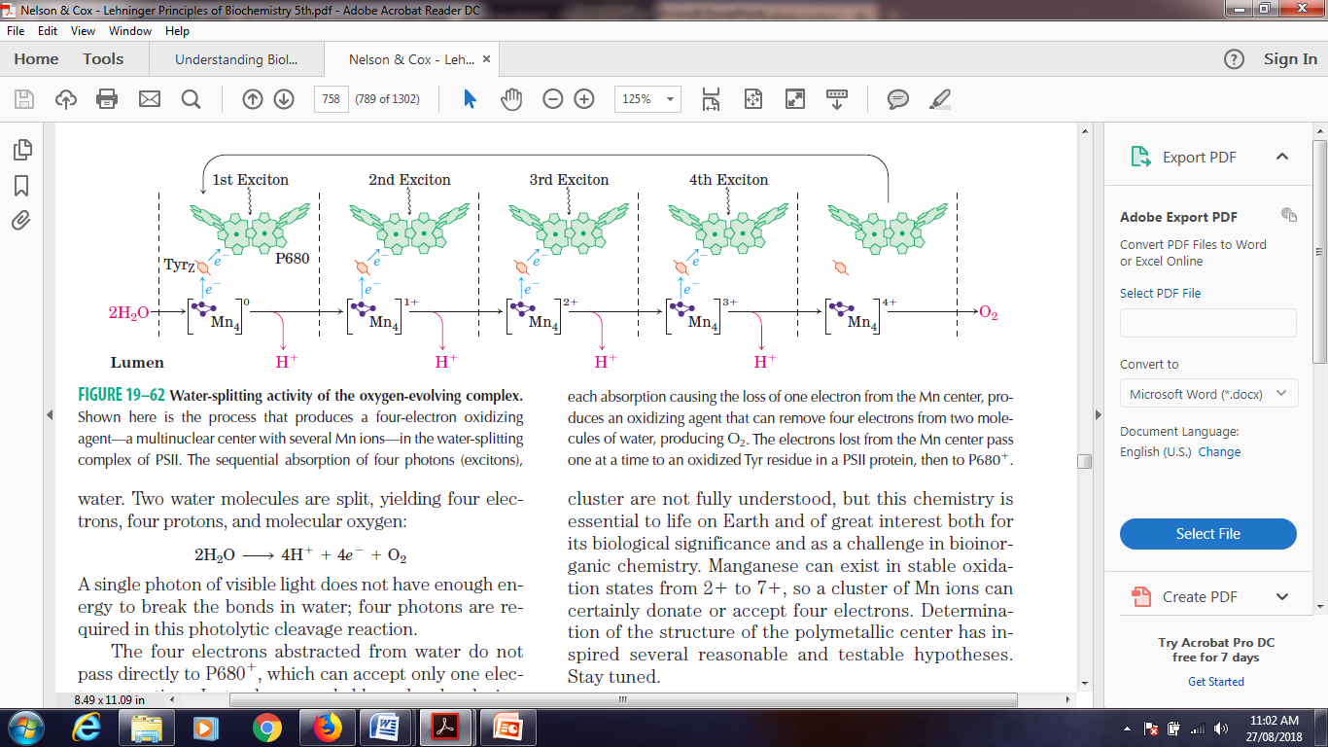
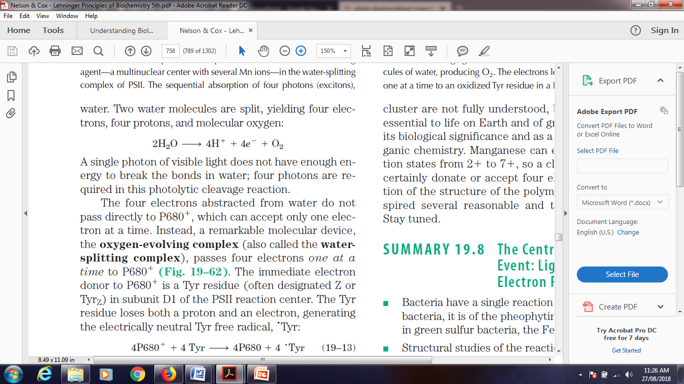
Two water molecules are split, yielding four electrons, four protons, and molecular oxygen. A single photon of visible light does not have enough energy to break the bonds in water; four photons are required in this photolytic cleavage reaction. The four electrons abstracted from water do not pass directly to P680, which can accept only one electron at a time. Instead, a remarkable molecular device, the oxygen-evolving complex (also called the water splitting complex), passes four electrons one at a time to P680

Slide 21
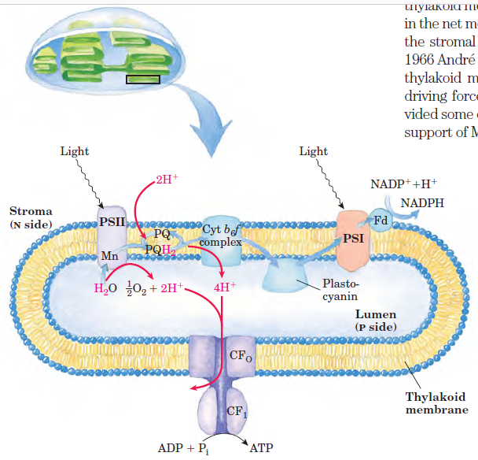

Slide 22
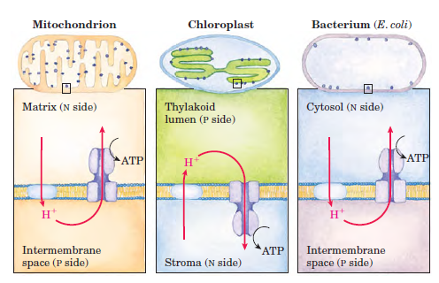

Slide 23
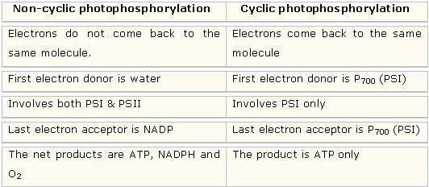

Slide 24
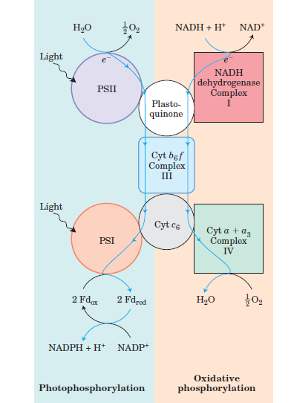
Summary

Slide 25
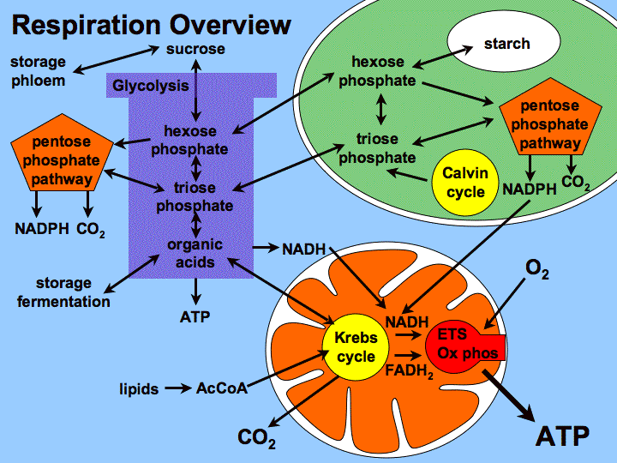

Slide 26
References:
1. Nelson And Cox, Lehninger Principles of Biochemistry, 6th edition
2. Bioinformatics: Joel Keizer
3. Images: Search engine Google.
4. Harper’s Biochemistry 26th Edition.
5. Genes- VIII, Lewin
6. Developmental Biology by Gilbert 7th Edition
7. Bruce Albert’s, Molecular biology of the cell, 5th edition.

